Slide 1
Distributed mutual exclusion
Notes:
In a single computer, all processes and threads share a common memory space. This shared memory allows for simple synchronization mechanisms, like a mutex, that can lock a resource by modifying a single variable or memory location.
In a distributed system, nodes do not share memory. Each node has its own separate memory space, so there’s no single memory location that all nodes can access to manage a mutex. To implement mutual exclusion, nodes must communicate over the network, which introduces delays, potential for message loss, and the need for complex coordination protocols.

Slide 2
Why we learn about distributed mutual exclusion
Resource Sharing in Distributed Systems
In a distributed system, multiple processes on different machines may need to access a shared resource, such as a file, database, or printer, at the same time
Avoiding Data Corruption and Conflicts
Without mutual exclusion, simultaneous access to a shared resource could lead to data corruption or inconsistency.
Fault Tolerance and Scalability
Mutual exclusion should work even if some nodes in the system fail.

Slide 3
Mutual exclusion support must meet following requirement
When mutual exclusion is enforced: Only one process at a time is allowed into its critical section, among all processes that have critical sections for the same resource or shared object.
A process that halts in its noncritical section must do so without interfering with other processes.
It must not be possible for a process requiring access to a critical section to be delayed indefinitely: no deadlock or starvation.
When no process is in a critical section, any process that requests entry to its critical section must be permitted to enter without delay.
No assumptions are made about relative process speeds or number of processors. (ME algorithm should not be dependent on the speed of nodes)
A process remains inside its critical section for a finite time only.

Slide 4
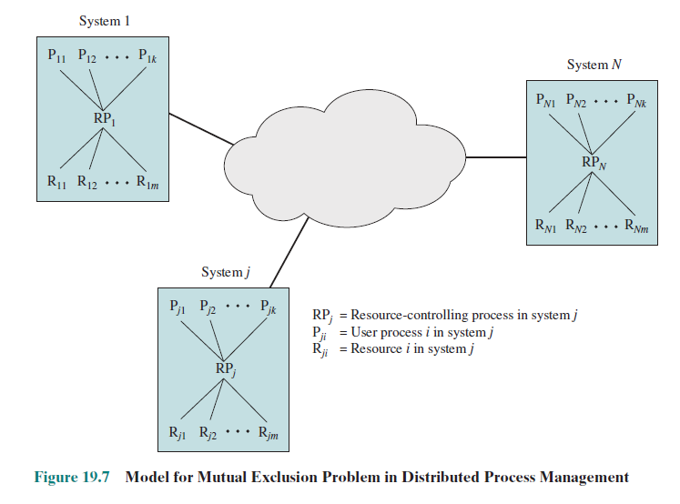
Notes:
We assume some number of systems interconnected
by some type of networking facility. Within each system, we assume some
function or process within the operating system is responsible for resource allocation.
Each such process controls a number of resources and serves a number of user processes.

Slide 5
Centralized algorithm for M.E.
one node is designated as the control node and controls access to all shared objects.
When any process requires access to a critical resource, it issues a Request to its local resource-controlling process.
This process, in turn, sends a Request message to the control node, which returns a Reply (permission) message when the shared object becomes available.
When a process has finished with a resource, a Release message is sent to the control node.

Slide 6
Key properties
Only the control node makes resource-allocation decisions.
All necessary information is concentrated in the control node, including the identity and location of all resources and the allocation status of each resource.

Slide 7
Centralized algorithm
Straightforward
The control node will not satisfy a request for a resource until that resource has been released.
Drawbacks
Single point of failure.
Control node becomes a bottleneck.

Slide 8
Distributed algorithm for M.E
A fully distributed algorithm is characterized by following properties
All nodes have roughly equal amount of information. (cannot expect some nodes to have extra information)
Each node has only some local information of the system. (local view not global view)
All nodes bear equal responsibility for the final decision. (no special privileges)
All nodes expand roughly equal effort in making a final decision.
Failure of a node does not make the system collapse. (more resilient to node failures)
There is no systemwide common clock for the whole system. (coordination happens using messages)
Notes:
Points 2 and 6 may require some elaboration. With respect to point 2, some
distributed algorithms require that all information known to any node be communicated
to all other nodes. Even in this case, at any given time, some of that information
will be in transit and will not have arrived at all of the other nodes. Thus, because of
time delays in message communication, a node’s information is usually not completely
up to date and is in that sense only partial information.
With respect to point 6, because of the delay in communication among systems,
it is impossible to maintain a system-wide clock that is instantly available to all systems.
Furthermore, it is also technically impractical to maintain one central clock and
to keep all local clocks synchronized precisely to that central clock; over a period of
time, there will be some drift among the various local clocks that will cause a loss of
synchronization.

Slide 9
Distributed algorithm for M.E.
It is the delay in communication, coupled with the lack of a common clock, that makes it much more difficult to develop mutual exclusion mechanisms in a distributed system compared to a centralized system.
Before looking at a distributed algorithm for M.E. we need to look at an approach to overcoming the clock inconsistency problem.
Why?
Difficulty in Determining Event Order.
Potential for Conflicting Access Requests.
Difficulty in Achieving Fairness.
Notes:
Points 2 and 6 may require some elaboration. With respect to point 2, some
distributed algorithms require that all information known to any node be communicated
to all other nodes. Even in this case, at any given time, some of that information
will be in transit and will not have arrived at all of the other nodes. Thus, because of
time delays in message communication, a node’s information is usually not completely
up to date and is in that sense only partial information.
With respect to point 6, because of the delay in communication among systems,
it is impossible to maintain a system-wide clock that is instantly available to all systems.
Furthermore, it is also technically impractical to maintain one central clock and
to keep all local clocks synchronized precisely to that central clock; over a period of
time, there will be some drift among the various local clocks that will cause a loss of
synchronization.

Slide 10
Ordering of event in a distributed system
We would like to be able to say that an event a at system i occurred before (or after) event b at system j, and we would like to be able to arrive consistently at this conclusion at all systems in the network.
Unfortunately
There may be a delay between the actual occurrence of an event and the time that it is observed on some other system.
The lack of synchronization leads to a variance in clock readings on different systems.
Notes:
Points 2 and 6 may require some elaboration. With respect to point 2, some
distributed algorithms require that all information known to any node be communicated
to all other nodes. Even in this case, at any given time, some of that information
will be in transit and will not have arrived at all of the other nodes. Thus, because of
time delays in message communication, a node’s information is usually not completely
up to date and is in that sense only partial information.
With respect to point 6, because of the delay in communication among systems,
it is impossible to maintain a system-wide clock that is instantly available to all systems.
Furthermore, it is also technically impractical to maintain one central clock and
to keep all local clocks synchronized precisely to that central clock; over a period of
time, there will be some drift among the various local clocks that will cause a loss of
synchronization.

Slide 11
Lamport timestamps
Orders events in a distributed system without using system clocks.
Some definitions
Event: Actions that occur at local system. (Ex: Process entering critical section)
A message is sent with each event.
Each system i maintains a local counter C_{i}.
When a system transmits a message, it increments the counter by 1, then the message is sent in the form of (m , T_{i} , i)
Notes:
Points 2 and 6 may require some elaboration. With respect to point 2, some
distributed algorithms require that all information known to any node be communicated
to all other nodes. Even in this case, at any given time, some of that information
will be in transit and will not have arrived at all of the other nodes. Thus, because of
time delays in message communication, a node’s information is usually not completely
up to date and is in that sense only partial information.
With respect to point 6, because of the delay in communication among systems,
it is impossible to maintain a system-wide clock that is instantly available to all systems.
Furthermore, it is also technically impractical to maintain one central clock and
to keep all local clocks synchronized precisely to that central clock; over a period of
time, there will be some drift among the various local clocks that will cause a loss of
synchronization.

Slide 12
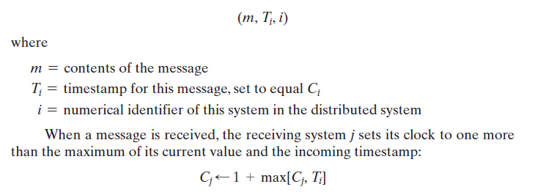

Slide 13
Lamport timestamps
Ordering of the events is determined by the following rules.
For a message x from site i and a message y from site j, x is said to precede y if one of the following conditions hold:
If T_{i} < T_{j}
If T_{i} = T_{j} and i < j
Two messages with the same timestamp are ordered by the numbers of their sites.
Notes:
Points 2 and 6 may require some elaboration. With respect to point 2, some
distributed algorithms require that all information known to any node be communicated
to all other nodes. Even in this case, at any given time, some of that information
will be in transit and will not have arrived at all of the other nodes. Thus, because of
time delays in message communication, a node’s information is usually not completely
up to date and is in that sense only partial information.
With respect to point 6, because of the delay in communication among systems,
it is impossible to maintain a system-wide clock that is instantly available to all systems.
Furthermore, it is also technically impractical to maintain one central clock and
to keep all local clocks synchronized precisely to that central clock; over a period of
time, there will be some drift among the various local clocks that will cause a loss of
synchronization.

Slide 14
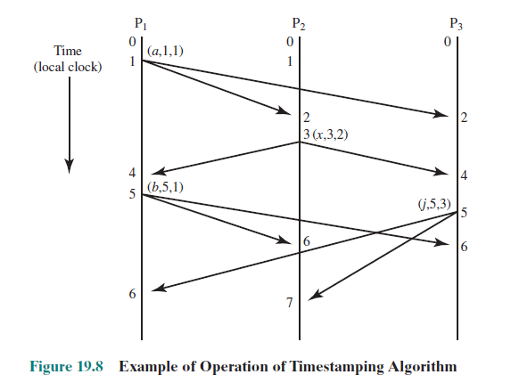

Slide 15
Lamport timestamps
Note the ordering imposed by this scheme does not necessarily correspond to the actual time sequence.
For the algorithms based on this timestamping scheme, it is not important which event actually happened first. It is only important that all processes that implement the algorithm agree on the ordering that is imposed on the events.
Notes:
Points 2 and 6 may require some elaboration. With respect to point 2, some
distributed algorithms require that all information known to any node be communicated
to all other nodes. Even in this case, at any given time, some of that information
will be in transit and will not have arrived at all of the other nodes. Thus, because of
time delays in message communication, a node’s information is usually not completely
up to date and is in that sense only partial information.
With respect to point 6, because of the delay in communication among systems,
it is impossible to maintain a system-wide clock that is instantly available to all systems.
Furthermore, it is also technically impractical to maintain one central clock and
to keep all local clocks synchronized precisely to that central clock; over a period of
time, there will be some drift among the various local clocks that will cause a loss of
synchronization.

Slide 16
Distributed queue
First version (proposed by Lamport)
First let’s go through our assumptions

Slide 17
Distributed queue (V1)
A distributed system consists of N nodes, uniquely numbered from 1 to N. Each node contains one process that makes requests for mutually exclusive access to resources on behalf of other processes; this process also serves as an arbitrator to resolve incoming requests from other nodes that overlap in time.
Messages sent from one process to another are received in the same order in which they are sent.
Every message is correctly delivered to its destination in a finite amount of time.
The network is fully connected; this means that every process can send messages directly to every other process.

Slide 18
Distributed queue (V1)
Each node keeps an array (queue) q. At any time, q[j] in the local array contains a message from P_{j}.
This array q is called a queue by Lamport even though it is not.

Slide 19
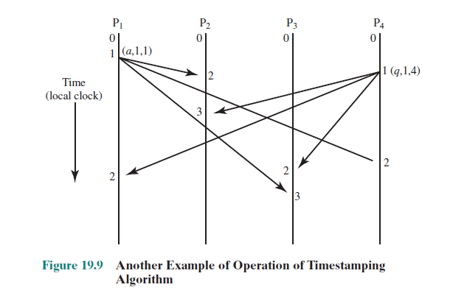

Slide 20
Distributed queue (V1)
Assumptions 2 and 3 can be realized using a reliable transport protocol, such as TCP.
The algorithm attempts to generalize an algorithm that would work in a straightforward manner in a centralized system.
If a single central process managed the resource, it could queue incoming requests and grant requests in a first-in-first-out manner.
To achieve this same algorithm in a distributed system, all of the sites must have a copy of the same queue. Timestamping can be used to assure that all sites agree on the order in which resource requests are to be granted.
before a process makes a decision based on its own queue, it must have received a message from all other sites. (why?)

Slide 21
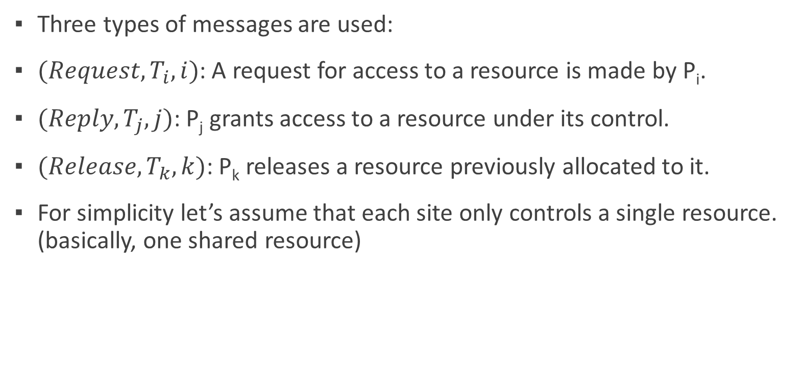
Distributed queue (V1)
Three types of messages are used:
$(Request, T_{i}, i)$: A request for access to a resource is made by P_{i}.
$(Reply, T_{j}, j)$: P_{j} grants access to a resource under its control.
$(Release, T_{k}, k)$: P_{k} releases a resource previously allocated to it.
For simplicity let’s assume that each site only controls a single resource. (basically, one shared resource)

Slide 22
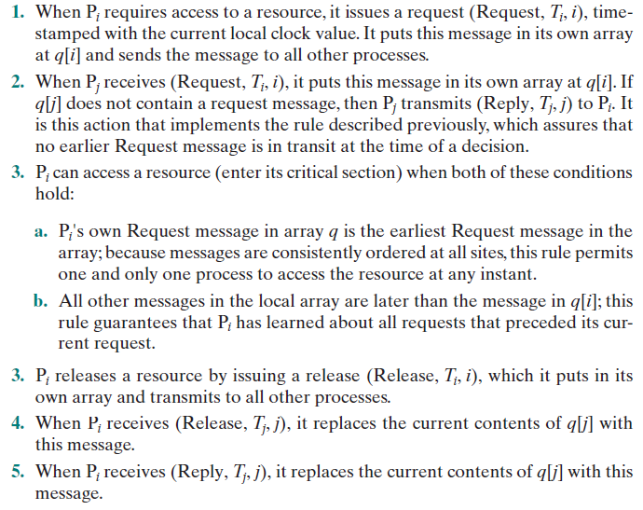

Slide 23
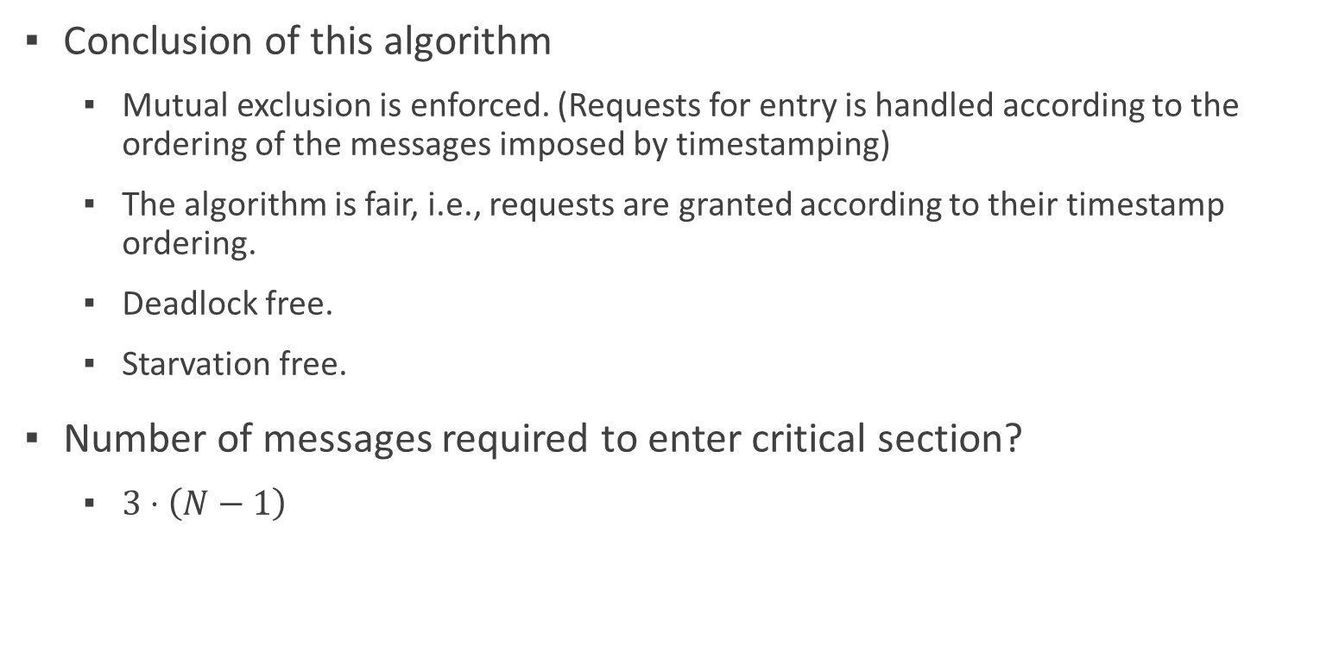
Distributed queue (V1)
Conclusion of this algorithm
Mutual exclusion is enforced. (Requests for entry is handled according to the ordering of the messages imposed by timestamping)
The algorithm is fair, i.e., requests are granted according to their timestamp ordering.
Deadlock free.
Starvation free.
Number of messages required to enter critical section?
$3⋅\left(N−1\right)$

Slide 24
Distributed queue (V2)
A refinement of the Lamport algorithm.
same as before, except that we do not necessarily require that messages sent from a process are received in the same order.
It seeks to optimize the original algorithm by eliminating Release messages.

Slide 25
When P_{i} requires access to a resource, it issues a request (Request, T_{i}, i), timestamped with the current local clock value. It puts this message in its own array at q[i] and sends the message to all other processes.
When P_{j} receives (Request, T_{i}, i), it obeys the following rules:
If P_{j} is currently in its critical section, it defers sending a Reply message (see Rule 4, which follows)
If P_{j} is not waiting to enter its critical section (has not issued a Request that is still outstanding), it transmits (Reply, T_{j}, j) to P_{i}.
If P_{j} is waiting to enter its critical section and if the incoming message follows P_{j}'s request, then it puts this message in its own array at q[i] and defers sending a Reply message.
If P_{j} is waiting to enter its critical section and if the incoming message Precedes P_{j}'s request, then it puts this message in its own array at q[i] and transmits (Reply, T_{j}, j) to P_{i}.
P_{i} can access a resource (enter its critical section) when it has received a Reply message from all other processes.
When P_{i} leaves its critical section, it releases the resource by sending a Reply message to each pending Request.

Slide 26
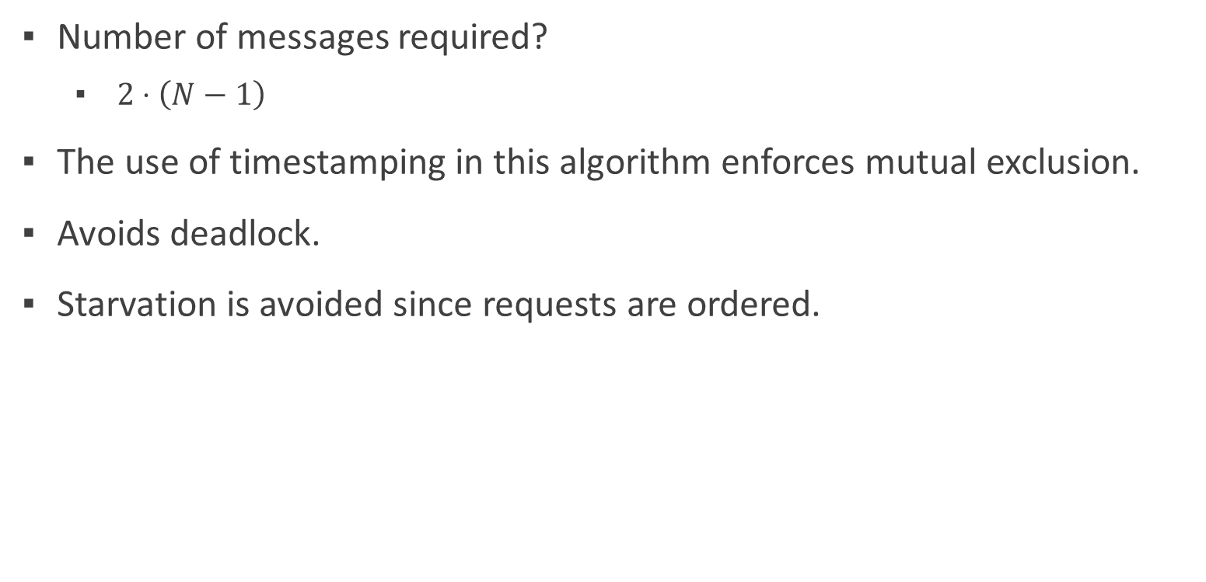
Distributed queue (V2)
Number of messages required?
$2⋅\left(N−1\right)$
The use of timestamping in this algorithm enforces mutual exclusion.
Avoids deadlock.
Starvation is avoided since requests are ordered.

Slide 27
Some famous distributed algorithms
For Leadership election
Bully Algorithm
Assumptions
Each process has a unique ID known to all members.
Any process may fail at any time.
Crash Detection: Nodes can detect failures, either through timeouts or lack of response.
Communication: Nodes can send messages to each other in the network.
Synchronous Network: Responses to messages are expected within a certain timeframe.

Slide 28
Bully Algorithm
Basic idea of this algorithm is that node with the highest ID should be the leader.
All processes do the following
Node p notices there is no reply from the coordinator .
P sends an elect message to all nodes with higher IDs.
If there is any reply, then P exits.
If there is no reply, then P wins. obtains any state needed to function as a leader, then sends a coordinator message to all processes.
On receipt of an elect message a process must both reply to the sender and start an election if it is not already holding one

Slide 29
A ring-based election algorithm
Assumptions
Ring Topology: Nodes (or processes) are arranged in a logical ring where each node knows only its immediate neighbors (the next node in the ring).
Unique IDs: Each node has a unique identifier (ID), typically a number.
Communication: Each node can send messages to its immediate neighbor in a unidirectional or bidirectional manner.
Failures: The algorithm can handle node failures but may need reconfiguration if a node in the ring fails during the election process.
All processes do the following
P notices the coordinator is not functioning.
P sends an elect message containing its own ID to the next process in the ring.
On receipt of an elect message
without the receiver’s ID
If the receiver’s node is higher- add the receivers node id to the message
If the receiver’s node is lower- keep the id in the message
with the receiver’s ID (the message has been around the ring)—send a message (coordinator, highest ID in the message) around the ring.

Slide 30
Imagine a ring of nodes with unique IDs: 1, 3, 7, 5, and 2, arranged in a ring in that order. Here’s how an election might proceed:
Node 3 detects that the leader is down and initiates the election. It sends an election message with ID 3.
Node 7 receives the message, sees that its ID (7) is higher, replaces the ID in the message with 7, and forwards it.
Node 5 receives the message, but its ID is lower than 7, so it forwards it unchanged.
Node 2 and Node 1 also forward it unchanged, as their IDs are lower.
The message returns to Node 3 with ID 7, so Node 3 declares Node 7 as the leader and sends a coordinator message with ID 7 around the ring.
All nodes receive the coordinator message, update their leader to Node 7, and the election is complete.

